Slide 1
Welcome to the health care providers full user guide
Mar 14, 2023

Slide 2
03
04
05
07
11
14
15
CONTENTS
Introduction
Purpose and Home Page
Profile Registration and Settings Platform Navigation Modules Pathways
Using the Dashboard FAQ Foundations of Diabetes Pathway Overview

Slide 3
Introduction
LearnDiabetes is an interactive, multimedia platform that provides easy to understand education and training for families of children and youth living with T1D to complement traditional diabetes teaching.
It is designed for:
Children and youth living with T1D
Caregivers and other family members
Individuals interested in learning more about T1D
LearnDiabetes can be introduced at diagnosis or any time during the family’s diabetes journey. It allows families to expand on the foundations of diabetes or have a refresher on certain topics.

Slide 4
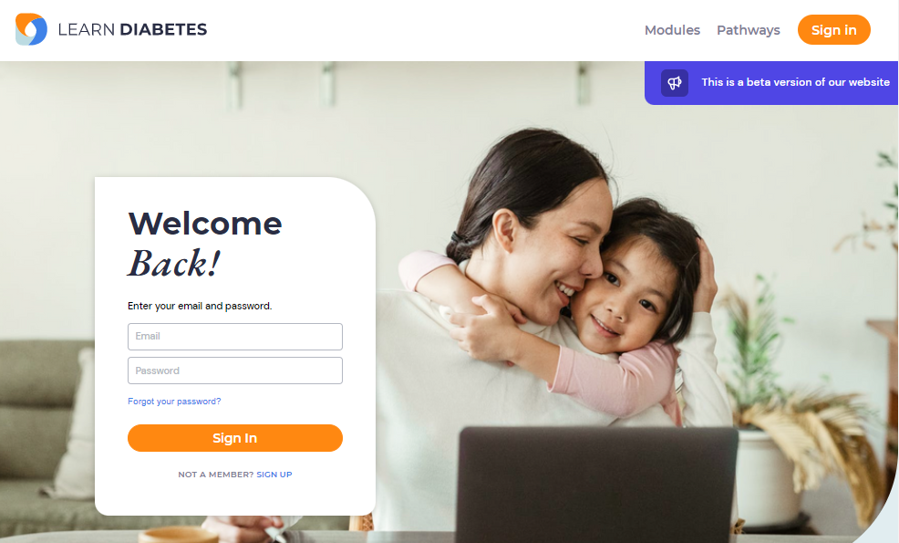
Purpose
This user guide has been designed to help health care providers support patients and families on how to use the LearnDiabetes virtual education platform.
It will guide individuals through the basic navigation and familiarize them with some of the key features. It will also address some of the frequently asked questions at the end.
Home page
Upon entering www.learndiabetes.ca, the home page will appear.
On the home page, learners can:
Register or sign in to their account
Access the learning modules and pathways
View the dashboard if they are signed in
Clicking on the logo on the top left of every page will bring them back to the home page.

Slide 5
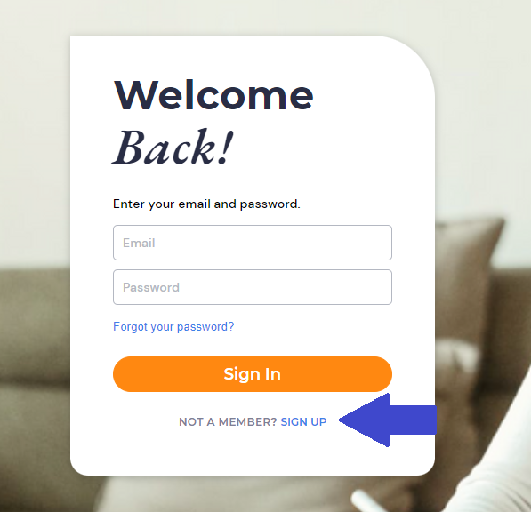
Profile Registration
Profile registration allows learners to keep track of the courses they have completed, have access to a personalized dashboard and enable gamification features.
To Sign Up, visit the home page and toggle to Sign Up as identified by the blue arrow in the image on the right.
Fill in the relevant user details and click the orange “Sign Up” button.
Learners will be prompted to visit their personalized dashboard upon registration.
To Sign In, go to the navigation bar at the top of any page and click on the orange Sign In button.
To Log Out of the account, click the user profile dropdown in the navigation bar and click “Logout”.
Individuals do not need to register for an account to access the learning modules.

Slide 6
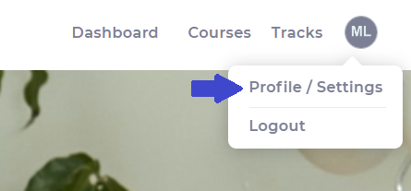
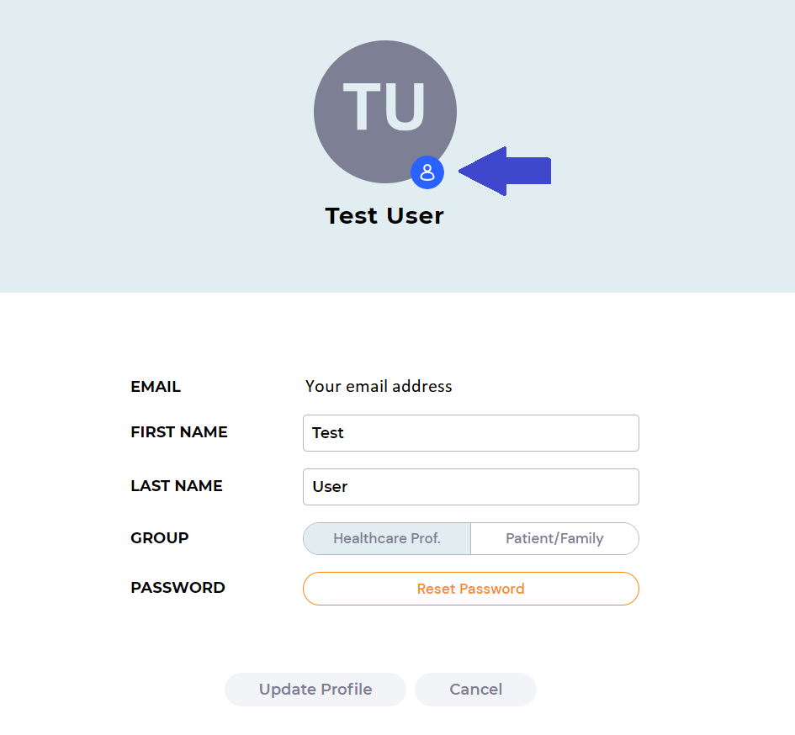
Profile Settings
To update profile information once signed in, go to the navigation bar and click on the user icon to dropdown and click on Profile/Settings as indicated by the blue arrow. Edit information and click “Update Profile” to save changes.
To change the profile image, click on the blue icon to upload or delete the photo.

Slide 7
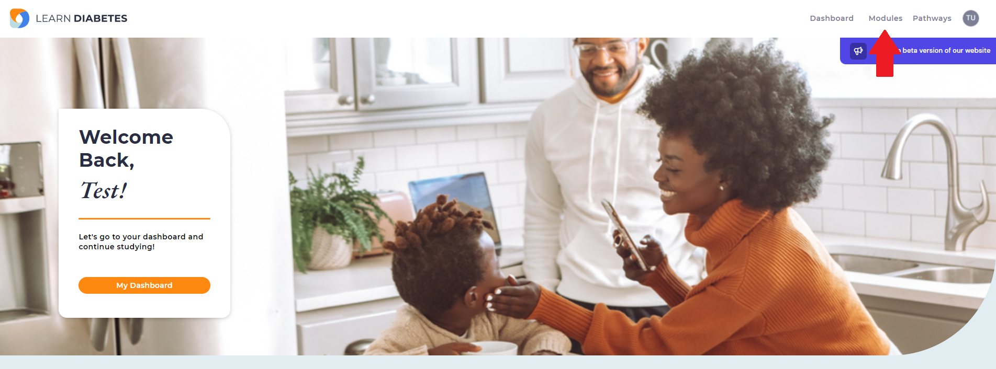
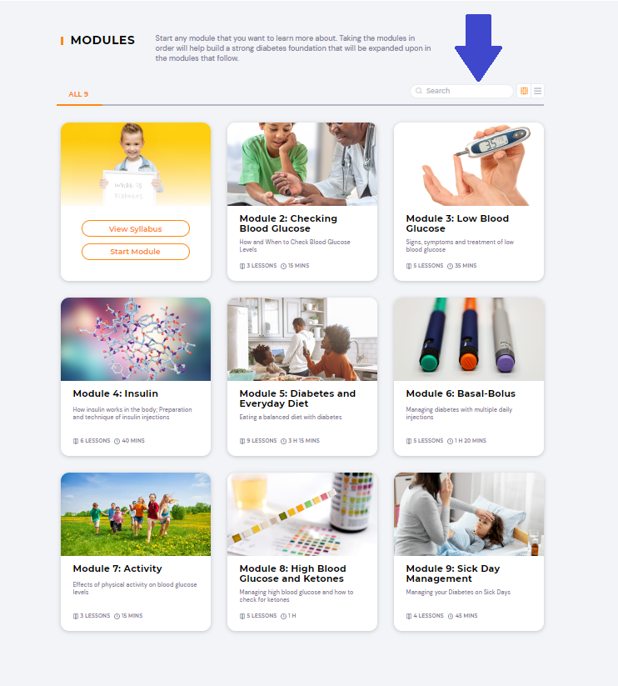
Platform Navigation
Modules
Modules can be accessed on the top right corner of the navigation bar.
Learners can start any module that they want to learn more about. Taking the modules in order will help build a strong diabetes foundation that will be expanded upon in the modules that follow.
Learners can find specific modules by typing in keywords in the search bar.

Slide 8
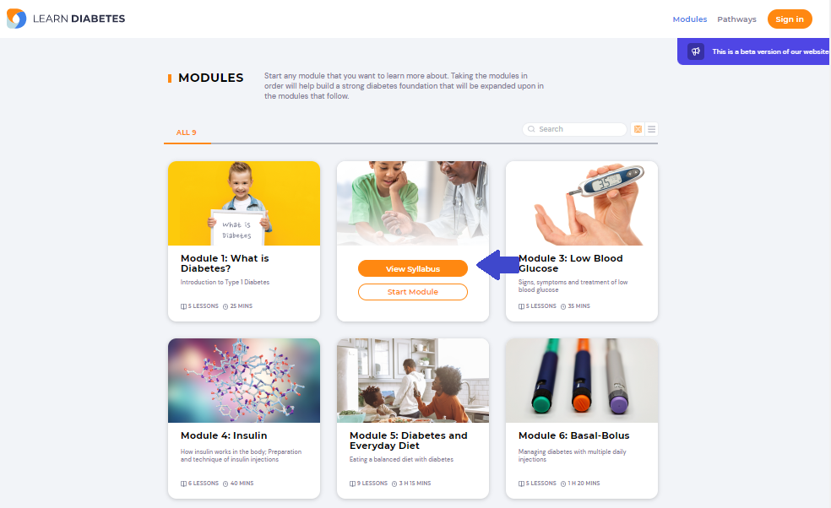
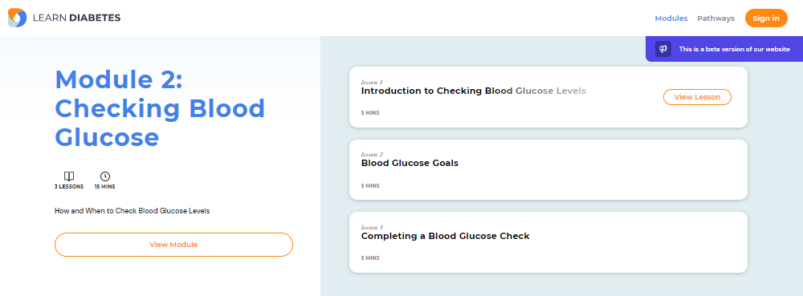
To view the syllabus, hover over the Module.
The syllabus will show the number of lessons and estimated time to complete.
Hovering over the title of the lesson will allow individuals to view and begin the lesson.

Slide 9
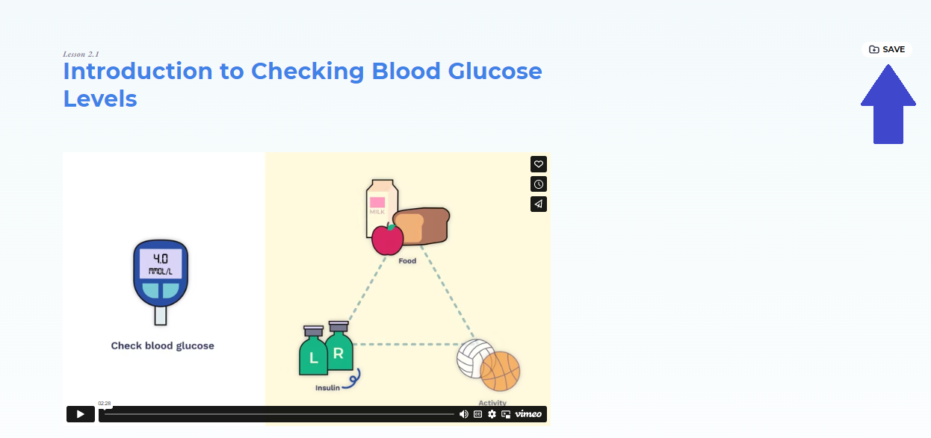
If they are signed in to their account, they will have an option to save the lesson to a folder for future reference.
In some lessons, there are accompanying videos. There is an option for the learner to view the video in a picture-in-picture format which shrinks the video into a small player to free the rest of the screen for other tasks.

Slide 10
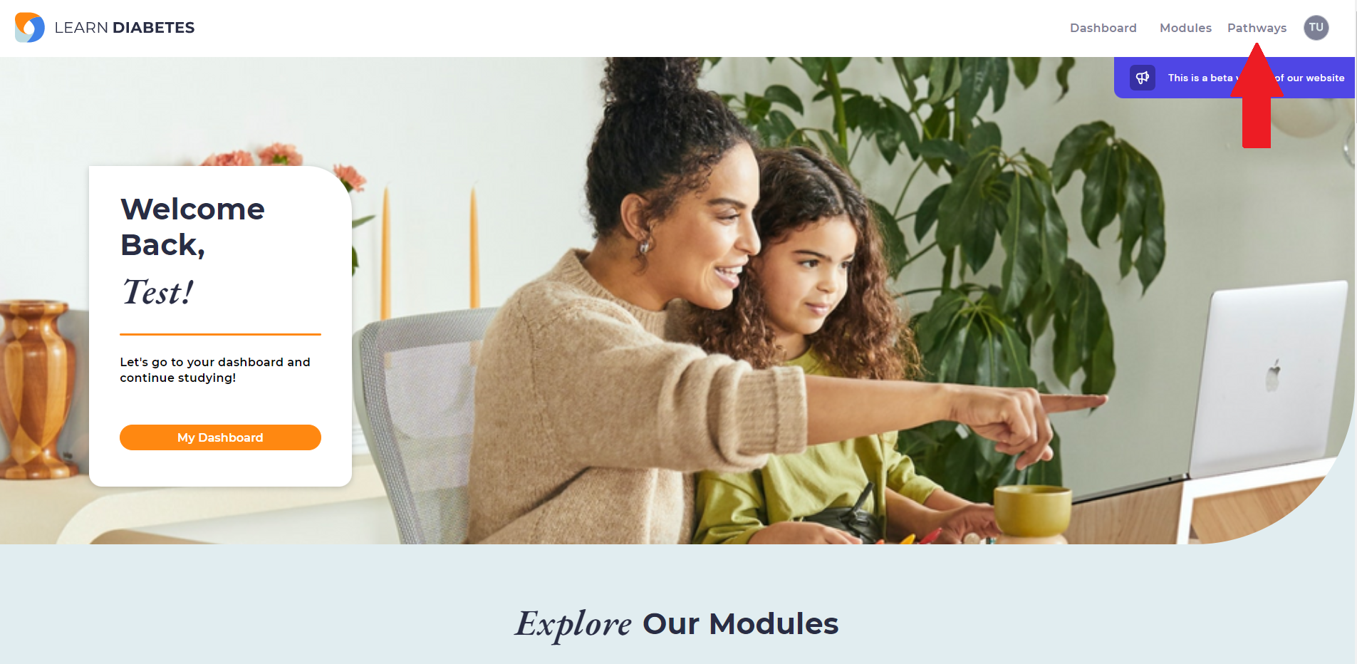
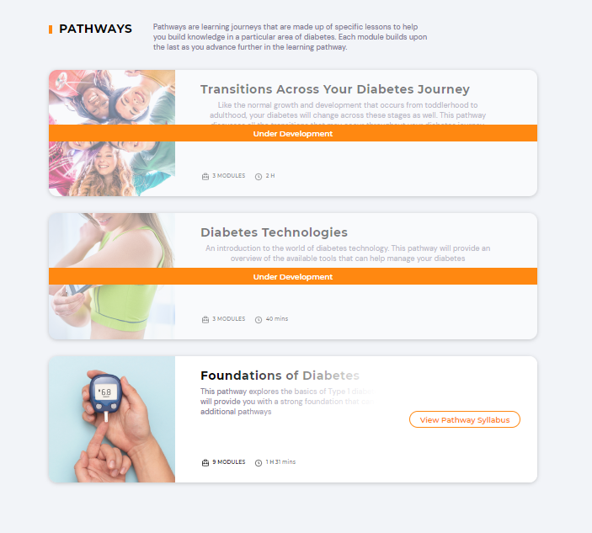
Platform Navigation
Pathways
Pathways can be accessed on the top right corner of the navigation bar.
These are learning journeys that are made up of specific modules to help build knowledge in a particular area of diabetes. Each module builds upon the last as learners advance further in the pathway.
Foundations of Diabetes is now available on the platform.
Diabetes Technologies and Transitions Across Your Diabetes Journey are currently in development.
To view the modules that are a part of the pathway, hover over the pathway and click on the button, View Pathway Syllabus.

Slide 11
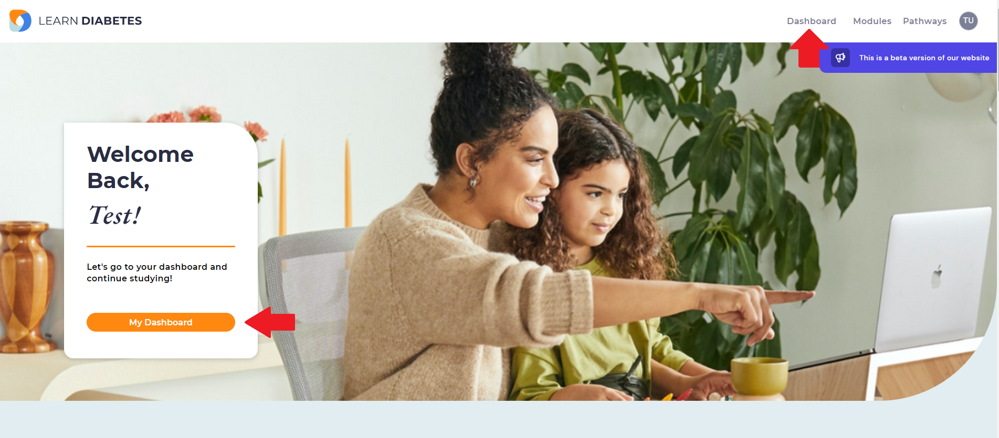
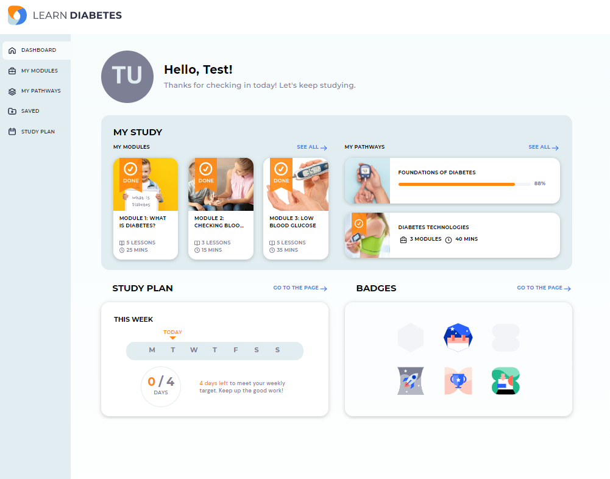
Using the Dashboard
Upon signing in, learners can access the dashboard on the
navigation bar on the top right or using the button on the home page.
The dashboard displays information in three categories:
My Study: Learning progress on Modules and Pathways
Study Plan: Allows individuals to set weekly learning targets
Badges: Displays achievements and milestones throughout their learning journey

Slide 12
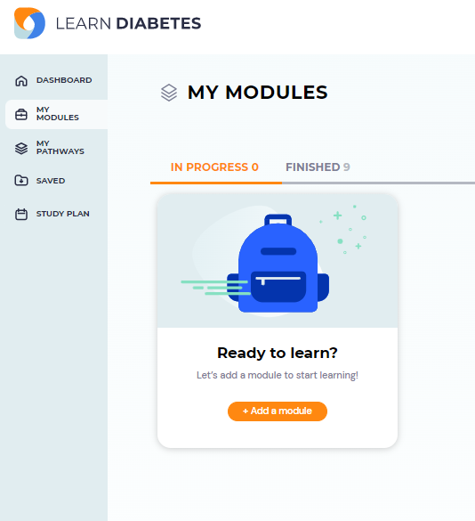
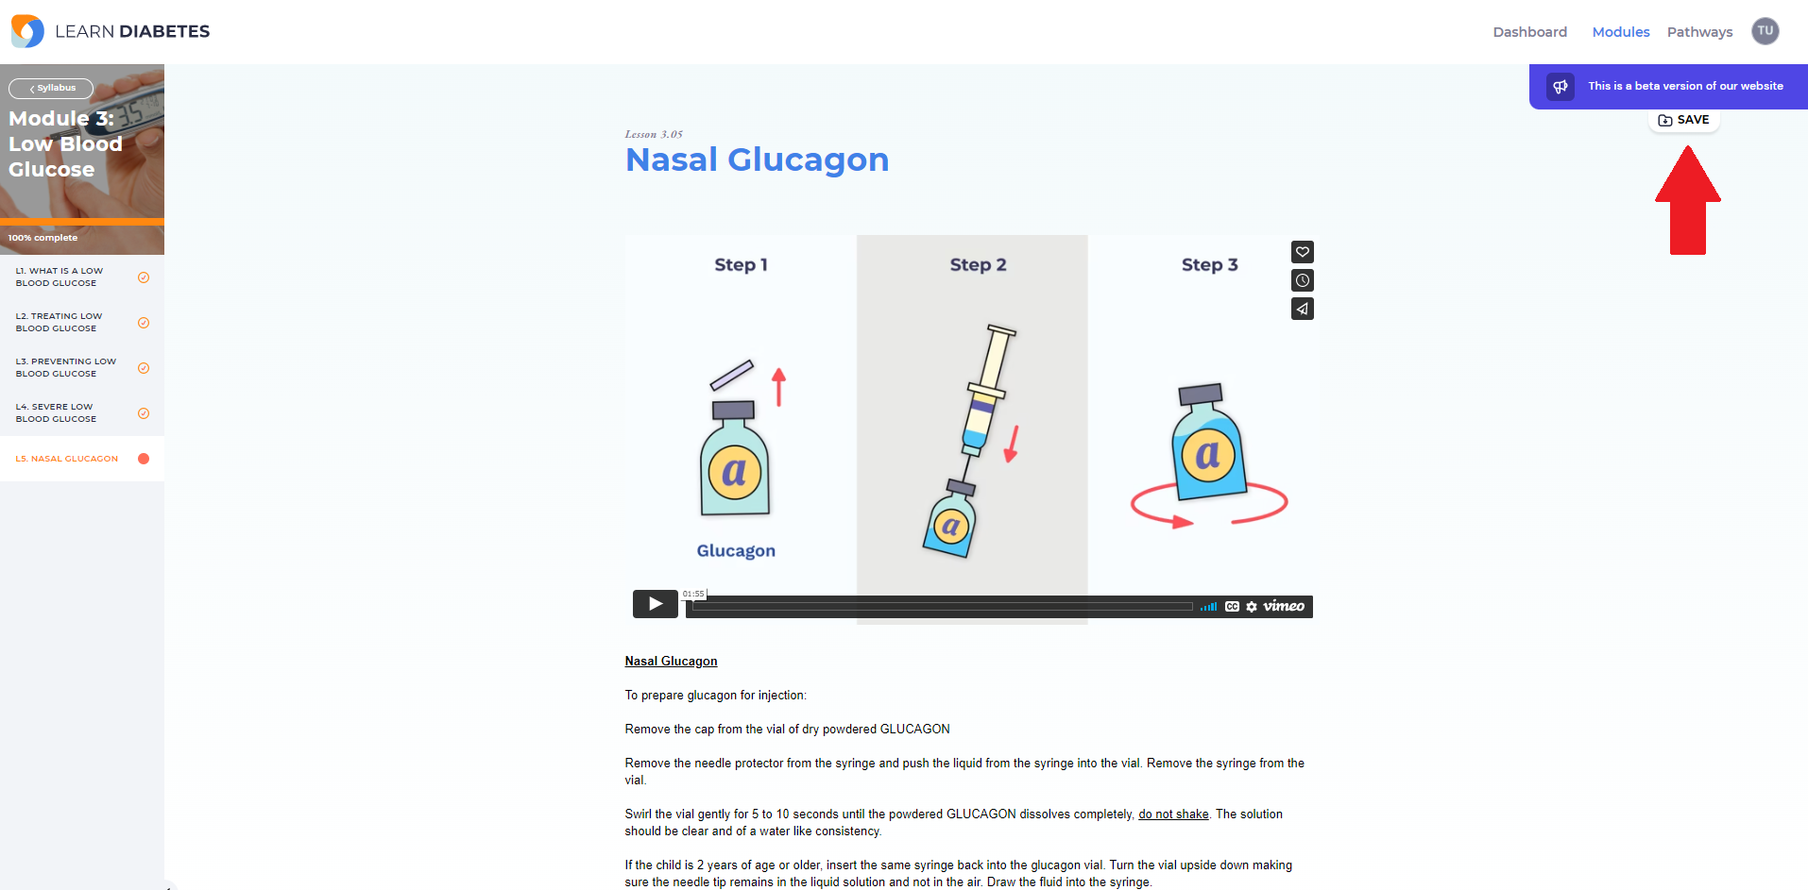
On the left, there is a navigation panel with five options.
My Modules and My Pathways show what learning materials are currently in progress and what is completed.
Saved is the folder where individuals can store lessons that they would like to revisit.
Click on the Save button at the top right corner of a lesson to add it to the Saved folder.

Slide 13
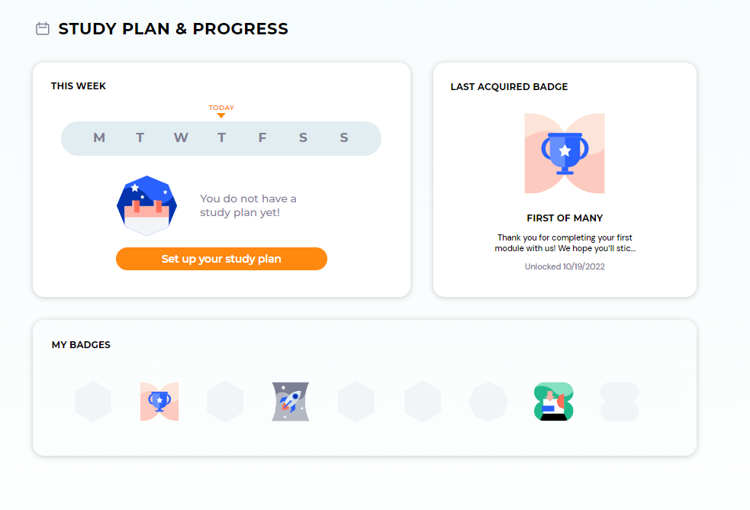
Learners can set up a simple study plan to establish learning targets for each week.
They can also see the list of badges earned and get a sneak peak of the ones that are available for collection.

Slide 14
Health Care Providers FAQ
What topics are currently covered in LearnDiabetes?
Foundations of Diabetes: This pathway explores the basics of T1D and its management. Modules include: Checking BG, Low BG, Insulin, Diabetes and Everyday Diet, Basal-Bolus, Physical Activity, High BG and Ketones, Sick Day Management
How could this platform be used by diabetes educators?
LearnDiabetes does not intend to replace traditional teaching. Diabetes educators can incorporate this tool into their teaching based on the needs of the family.
It could also be introduced to families while they are awaiting their teaching sessions.
What are future learning pathways in development?
Diabetes Technologies
Transitions Across Your Diabetes Journey
Is account registration required to access the learning modules?
LearnDiabetes is free for everyone to use.
Registration is not required to view the learning modules but it provides tracking of the learning journey, access to the dashboard and gamification features.
Accessibility Considerations:
The optimal experience to use LearnDiabetes is using a PC/laptop as it is a web-based application. Tablet and mobile phone access will have fewer functionalities available.
Only available in English at this time.

Slide 15
Foundations of Diabetes Pathway Overview
Module 1: What is Diabetes
Title | Video length if applicable | What does it cover?
Lesson 1: Intro to Diabetes | 2 mins 18 s | What is glucose, introduces pancreas and the role of insulin
Lesson 2: Type 1 Diabetes and Type 2 Diabetes | 2 mins 40 s | Pathophysiology of T1D, defines autoimmune disease
Lesson 3: Honeymoon Period | 1 min 39 s | Describes honeymood period
Lesson 4: Treatment | 52 s | Can only be treated with insulin injections at present
Lesson 5: Common Reactions to a Diagnosis of Type 1 | Text based | Common reactions and feelings families may experience post dx
Module 3: Low Blood Glucose
Title | Video length if applicable | What does it cover?
Lesson 1: What is a Low Blood Glucose? | Text Based | Defines hypoglycemia, discusses why it may occur, reviews symptoms
Lesson 2: Treating Low Blood Gluocse | 2 mins 6 s | Treating with fast acting glucose, introduces “Check, Treat, Repeat” steps
Lesson 3: Preventing Low Blood Glucose | Text Based | How to prevent, when to contact diabetes team, wearing medical ID
Lesson 4: Severe Low Blood Glucose | 1 min 31 s | Signs and symptoms, introduces glucagon
Lesson 5: Injectable Glucagon | 1 min 55 s | How to prepare injectable glucagon, dose based on age, how to inject and follow up steps
Lesson 6: Nasal Glucagon | Text based with link | Links Baqsimi website – how to prepare and give the dose, what to do after
Module 2: Checking Blood Glucose
Title | Video length if applicable | What does it cover?
Lesson 1: Introduction to Checking Blood Glucose Levels | 2 mins 28 s | When to check BG’s, meter stores readings, introduces sensors but reiterates that this module focuses on using a blood glucose meter
Lesson 2: Blood Glucose Goals | 49 s | BG targets
Lesson 3: Completing a Blood Glucose Check | Self paced, storybook style | How to use generic glucometer and lancing device and disposal of sharps
Module 4: Insulin
Title | Video length if applicable | What does it cover?
Lesson 1: How Does Insulin Work? | 1 min 59 s | Introduces concept of MDI/Basal-Bolus
Lesson 2: Where Can I Give Insulin? | 40 s | Injection sites, importance of rotation, changing site selection based on activity
Lesson 3: Setting Up an Insulin Pen/Syringe | Text based | Setting up an insulin pen and syringe
Lesson 4: How Do I Give Insulin? | 1 min 26 s | Injecting into subcutaneous tissue, how to inject, counting to 10 post injection
Lesson 5: Taking Care of Insulin and Sharps | 1 min 12 s | Storing extra insulin and obtaining sharps container/disposing of sharps
Lesson 6: Needle Phobia Resources | Text based | Helpful and unhelpful caregiver behaviours, resources and handouts

Slide 16
Foundations of Diabetes Pathway Overview
Module 5: Diabetes and Everyday Diet
Title | Video length if applicable | What does it cover?
Lesson 1: Food Choices for Children and Teens with Diabetes | 1 min 1 s, 1 min 52 s, 59 s, Interactive | Overview of three main energy sources: carbohydrates, protein and fat
Lesson 2: Carbohydrate Counting and Apps and Resources | 31 s, 1 min 36 s | What carbohydrate counting is, label reading, BCCH Carb Counting Resource, nutrition apps, activities
Lesson 3: Speed of Sugar | 3 mins 8 s | Fast-acting carbohydrates and starchy carbohydrates, fibre
Lesson 4: Graph- How Quickly Do Foods Raise Blood Sugar? | 1 min 42 s | Graph showing the speed at which different foods affect BG
Lesson 5: Carbohydrate Counting Using Carbohydrate Percentages | 44 s | How to calculate carbs using a food scale
Lesson 6: How to Calculate Carbohydrates in Recipes | 44 s | Identifying which foods need to be counted, tools for calculating, interactive example
Lesson 7: Using the Common Baking Ingredients and Their Nutrient Contents | Text based | Handout with common baking ingredients and their nutrient contents
Lesson 8: Sugars and Sweeteners | 4 mins 14 s | Sugars, sugar alcohols and sugar substitutes
Lesson 9: Supporting Food Choices for Children and Youth with Diabetes by Age | Storybook style | Specific age-related diabetes nutrition recommentations and considerations
Module 7: Activity
Title | Video length if applicable | What does it cover?
Lesson 1: Physical Activity and Blood Glucose | 1 min 52 s | How to be active, introduces Live 5210, when not be active (illness/ketones)
Lesson 2: Types of Activity & Competitive Sports | 1 min 5 s | Introduces concepts of aerobic and anaerobic activities with possible effect on blood glucose
Lesson 3: Preparing for Physical Activity | Storybook style | Lowering risk of hypoglycemia with activity, introduces activity snack
Module 8: High Blood Glucose and Ketones
Title | Video length if applicable | What does it cover?
Lesson 1: What is a High Blood Glucose? | Text based | Potential causes of high BG and symptoms
Lesson 2: What Do I Do if My Blood Glucose is High? | 1 min 41 s | Checking BG, when to give correction, when to check for ketones
Lesson 3: Diabetic Ketoacidosis (DKA) | 58 s | Warning signs of DKA, medical emergency
Lesson 4: 5-10-15-20 Rule | 2 mins 53 s | Steps for 5-10-15-20 rule
Lesson 5: 5-10-15-20 Rule Interactive Activity | Interactive activity | Work through example of high BG and moderate ketones
Module 6: Basal-Bolus
Title | Video length if applicable | What does it cover?
Lesson 1: Basal-Bolus Insulin Therapy | Text based | Intro to basal and bolus insulin
Lesson 2: How to Calculate Bolus Insulin | 2 mins 53 s | How to use Bolus Calculation Worksheet including current BG, target BG, ISG and ICR
Lesson 3: Bolus Calculation Resources | Text based with links | Introduces BolusCalc app
Lesson 4: Insulin Stacking | 40 s | Introduces stacking, interacting example for calculating insulin dose
Lesson 5: How to Prevent Insulin Stacking | 22 s | How to give insulin without insulin stacking, interactive example on calculating only carb bolus
Module 9: Sick Day Management
Title | Video length if applicable | What does it cover?
Lesson 1: Overview and Key Points | 48 s | Overview: Check BG’s, check for ketones, get enough fluids
Lesson 2: Tips for Illness Management | Interactive | Reviews 7 tips to follow for illness
Lesson 3: Illness and DKA | Text based | When to call diabetes team and/or go to the emergency department
Lesson 4: Mini Dose Glucagon | 2 mins 55 s | How to prepare and administer mini dose glucagon

